Slide 1
Unit VI
Expression Evaluation, Huffman coding, Heap for Kth smallest/largest element

Slide 2
Expression Evaluation
Application of Binary Trees: To Evaluate a given binary expression tree representing algebraic expressions.

Slide 3
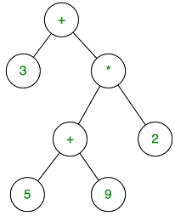
Sample Expression: 3 + ((5+9) * 2)
What is the VALUE of the following expression tree?
Ans:

Slide 4
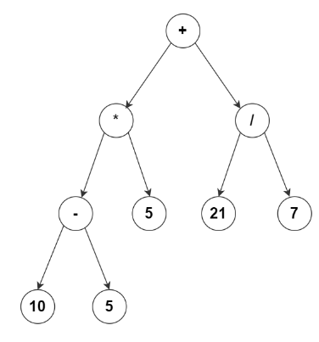
What is the VALUE of the following expression tree?
Ans:

Slide 5

class Node
{
String val;
Node left, right;
Node(String val)
{
this.val = val;
this.left = this.right = null;
}
}
class Main
{
// Utility function to check if a given node is a leaf node [isLeaf]
// Function to apply an operator 'op' to values 'x' and 'y' and return the result [Process]
// Recursive function [Evaluate]to evaluate a binary expression tree
//public static void main(String[] args)
{
}
}

Slide 6

public static void main(String[] args)
{
Node root = new Node("+");
root.left = new Node("*");
root.right = new Node("/");
root.left.left = new Node("-");
root.left.right = new Node("5");
root.right.left = new Node("21");
root.right.right = new Node("7");
root.left.left.left = new Node("10");
root.left.left.right = new Node("5");
System.out.println("The value of the expression tree is " + Evaluate(root));
}
//////////////////////////////

Slide 7
// Utility function to check if a given node is a leaf node
public static boolean isLeaf(Node node) {
return node.left == null && node.right == null;
}
////////////////////////////////////

Slide 8
// Function to apply an operator 'op' to values 'x' and 'y' and return the result
public static double PROCESS(String op, double x, double y)
{
if (op.equals("+")) { return x + y; }
if (op.equals("-")) { return x - y; }
if (op.equals("*")) { return x * y; }
if (op.equals("/")) { return x / y; }
return 0;
}
/////////////////////////////

Slide 9
public static double Evaluate(Node root)
{
// base case: invalid input
if (root == null) {
return 0;
}
// the leaves of a binary expression tree are operands
if (isLeaf(root)) {
return Double.valueOf(root.val);
}
// recursively evaluate the left and right subtree
double x = Evaluate(root.left);
double y = Evaluate(root.right);
// apply the operator at the root to the values obtained in the previous step
return PROCESS(root.val, x, y);
}
///////////////////////////////////////////

Slide 10
class ABC {
String value;
ABC left;
ABC right;
ABC(String value) {
this.value = value;
}
ABC(String value, ABC left, ABC right) {
this.value = value;
this.left = left;
this.right = right;
}
}
public class XYZ {
public int evaluate(ABC node){
if (node.value.equals("/")) {
return evaluate(node.left) / evaluate(node.right);
} else if (node.value.equals("*")) {
return evaluate(node.left) * evaluate(node.right);
} else if (node.value.equals("-")) {
return evaluate(node.left) - evaluate(node.right);
} else if (node.value.equals("+")) {
return evaluate(node.left) + evaluate(node.right);
} else {
return Integer.valueOf(node.value);
}
}
public static void main(String[] args) {
XYZ ET = new XYZ();
ABC ET_root = new ABC("+");
ET_root.left = new ABC("3");
ET_root.right = new ABC("*");
ET_root.right.left = new ABC("+");
ET_root.right.left.left = new ABC("5");
ET_root.right.left.right = new ABC("9");
ET_root.right.right = new ABC("2");
// 31 should be printed
System.out.println(ET.evaluate(ET_root));
}
}
What is the Java Code doing?

Slide 11
Huffman Coding
Application of Binary Trees: Generate Huffman Code for given string

Slide 12
HUFFMAN CODING
Huffman coding is a lossless data compression algorithm.
The idea is to assign variable-length codes to input characters, lengths of the assigned codes are based on the frequencies of corresponding characters.
The most frequent character gets the smallest code and the least frequent character gets the largest code.
Huffman Coding prevents any ambiguity in the decoding process using the concept of prefix code

Slide 13
Huffman’s Code
ASCII is a fixed length code of 7 bits
In text, some characters having very high frequency of occurrence and some with very low frequency of occurrence
In Huffman’s code, characters that occur more frequently will be assigned shorter codes and with lower frequency will be assigned longer codes
Popular for data compression algorithm
Sample Problem
E=15 | T=12 | A=10 | O=8 | R=7 | N=6 | S=5
U=5 | I=4 | D=4 | M=3 | C=3 | G=2 | K=2

Slide 14
Ambiguity in Variable Length Encoding
The variable-length codes assigned to input characters are Prefix Codes, means the codes (bit sequences) are assigned in such a way that the code assigned to one character is not the prefix of code assigned to any other character.
This is how Huffman Coding makes sure that there is no ambiguity when decoding the generated bitstream.

Slide 15
…contd..Ambiguity in Variable Length Encoding
Let there be four characters
a, b, c and d,
and their corresponding variable length codes be
00, 01, 0 and 1
This coding leads to ambiguity because code assigned to c is the prefix of codes assigned to a and b.
If the compressed bit stream is 0001, the de-compressed output may be “cccd” or “ccb” or “acd”..

Slide 16
Huffman’s code - Algorithm
Organize character set into row ordered according to frequency
Find two nodes with smallest combined frequency and join them
Weight of new node is combined weights of two nodes
Sum of weights of the nodes chosen must be smaller than the combination of any other possible choices
Repeat above steps till we get single tree
If more number of leaves with same weight then choose nearest

Slide 17
Sample Problem
E=15 | T=12 | A=10 | O=8 | R=7 | N=6 | S=5
U=5 | I=4 | D=4 | M=3 | C=3 | G=2 | K=2
10
18
04
06
10
08
13
18
G
K
M
C
S
U
I
D
R
N
A
O
E
T
02
02
03
03
05
05
04
04
07
06
10
08
15
12

Slide 18
Huffman Code
86
1
0
50
36
22
1
0
18
10
0
28
1
18
10
08
13
06
04
0
1
0
1
0
1
A
O
S
U
I
D
E
R
N
M
C
G
K
T
10
08
05
05
04
04
15
07
06
03
03
02
02
12

Slide 19
Huffman coding is done with the help of the following steps.
Calculate the frequency of each character in the string
Sort the characters in increasing order of the frequency.
Make each unique character as a leaf node.
Create an empty node z. Assign the minimum frequency to the left child of z and assign the second minimum frequency to the right child of z. Set the value of the z as the sum of the above two minimum frequencies.
Remove these two minimum frequencies from Q and add the sum into the list of frequencies
Insert node z into the tree.
Repeat steps 3 to 5 for all the characters.
For each non-leaf node, assign 0 to the left edge and 1 to the right edge

Slide 20
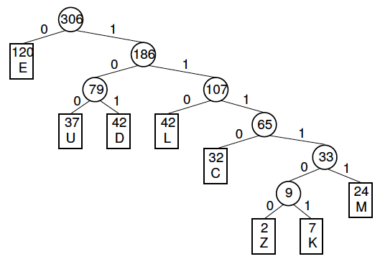

Slide 21
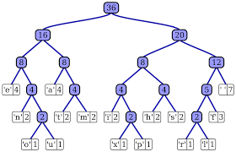

Slide 22
How is it used
Huffman coding first creates a tree using the frequencies of the character and then generates code for each character.
Once the data is encoded, it has to be decoded.
Decoding is done using the same tree.

Slide 23
ACCCABDAAACCCDD
Character | Frequency | Code | Size
A | 5 | 11 | 5*2 = 10
B | 1 | 100 | 1*3 = 3
C | 6 | 0 | 6*1 = 6
D | 3 | 101 | 3*3 = 9

Slide 24
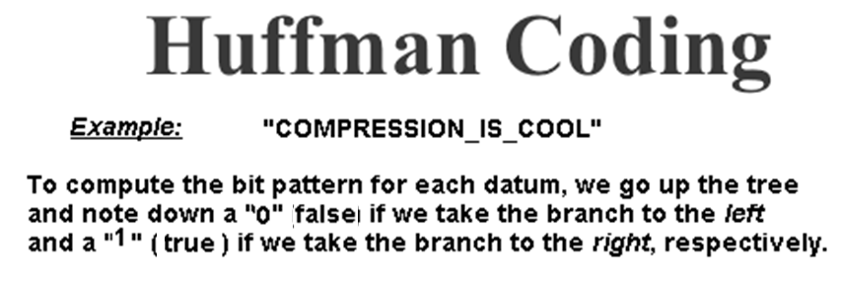

Slide 25
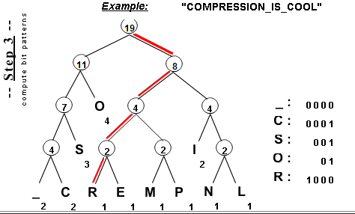

Slide 26
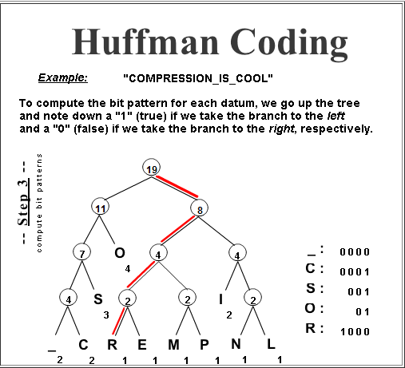

Slide 27
Applications of Heap

Slide 28
Kth largest (smallest) element in an algorithm

Slide 29
Method - Use Max Heap
1) Build a Max Heap tree in O(n)
2) Use Extract Max k times to get k maximum elements from the Max Heap O(klogn)
Time complexity: O(n + klogn)

Slide 30
Applications of HEAP
Priority Queues: Priority queues can be efficiently implemented using Binary Heap because it supports insert(), delete() and extractmax(), decreaseKey() operations in O(logn) time.

